Slide 1
ST. ANN’S COLLEGE OF ENGINEERING AND TECHNOLOGY,CHIRALA
DEPARTMENT OF ELECTRICAL AND ELECTRONICS ENGINEERING
BATCH NO: 17
IMPROVING POWER SYSTEM STABILITY USING STATIC SYNCHRONOUS SERIES COMPENSATOR
PROJECT ASSOCIATES
P.Nagahareesh 10F01A0292
R.Divya 10F01A0296
N.Ashok kumar 11F05A0216
V.Ranganayakulu 10F01A02B1
PROJECT GUIDE
Mr.Y.NARAYANARAO _{MTECH}
Notes:
PROJECT GUIDE

Slide 2
Outline
Objectives
FACTS-Technology
INTRODUCTION
Block diagram of SSSC Device
OUTPUT WAVEFORMS
CONCLUSION
Notes:
OBJECTIVE :

Slide 3
OBJECTIVE
The main aim of the project is used to investigate the effect of a static synchronous series compensator in controlling active and reactive powers as well as damping power system oscillations in transient mode.
In this source of energy in the dc link can supply or absorb reactive and active power from the line .
Simulation results obtained for selected bus-3 in two machine power system
SSSC is a one of the facts device controlling the power flows, achieving the active and reactive powers, damping oscillations appropriately.
Notes:
OBJECTIVE

Slide 4
FACTS TECHNOLOGY
Flexible AC Transmission System (Facts) is a new integrated concept based on power electronic switching converters and dynamic controllers to enhance the system utilization and power transfer capacity as well as the stability, security, reliability and power quality of AC system interconnections.
Use
Power Flow Control
Series Compensation
Voltage Regulation of Long Transmission System
Economic Operation
Voltage Stability Enhancement
Notes:
FACTS TECHNOLOGY

Slide 5
INTRODUCTION
Now a days there is a need for flexible and fast power flow control in the transmission system
This can be achieved by the usage of SSSC in power system
Basically SSSC is a member of Facts family
SSSC consist of a solid state voltage source converter
Notes:
INTRODUCTION

Slide 6
Static Synchronous Series Compensator
This device work the same way as the STATCOM. It has a voltage source converter serially connected to a transmission line through a transformer. It is necessary an energy source to provide a continuous voltage through a condenser and to compensate the losses of the VSC.
A SSSC is able to exchange active and reactive power with the transmission system. But if our only aim is to balance the reactive power , the energy source could be quite small. The injected voltage can be controlled in phase and magnitude if we have an energy source that is big enough for the purpose.
With reactive power compensation only the voltage is controllable, because the voltage vector forms 90º degrees with the line intensity. In this case the serial injected voltage can delay or advanced the line current. This means that the SSSC can be uniformly controlled in any value, in the VSC working slot.

Slide 7
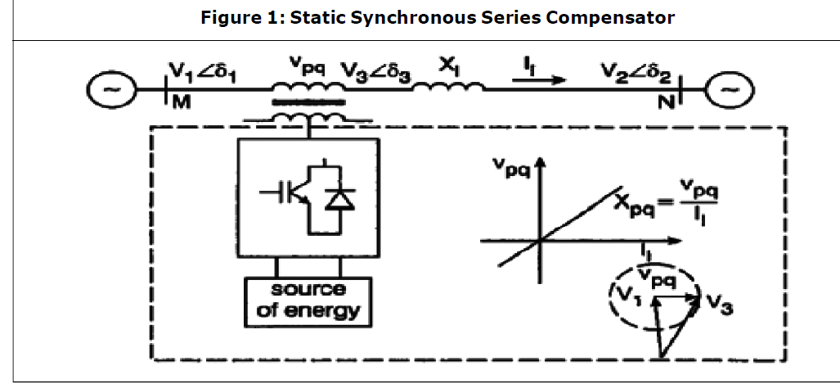
BLOCK DIAGRAM FOR SSSC :
The Static Synchronous Series Compensator (SSSC) uses a VSC interfaced in series to a transmission line, as shown in the Figure.
Again, the active power exchanged with the line has to be maintained at zero - hence, in steady state operation, SSSC is a functional equivalent of an infinitely variable series connected capacitor. The SSSC offers fast control and it is inherently neutral to sub-synchronous resonance.
Notes:
BLOCK DIAGRAM FOR SSSC :

Slide 8
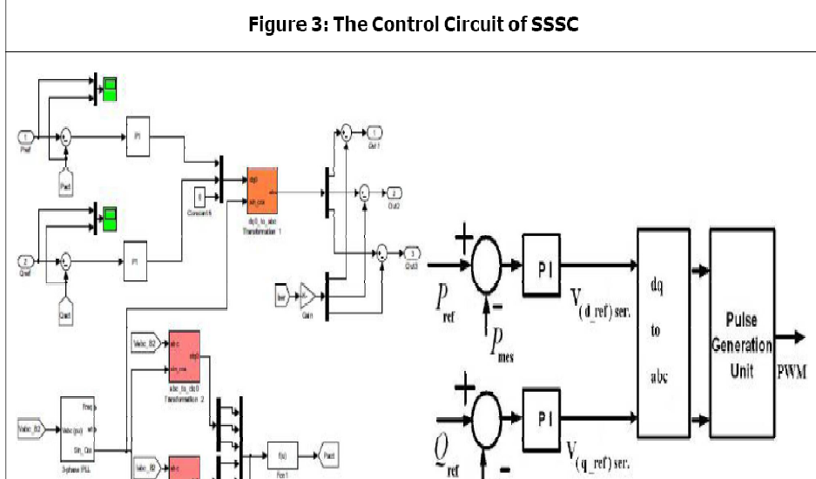

Slide 9
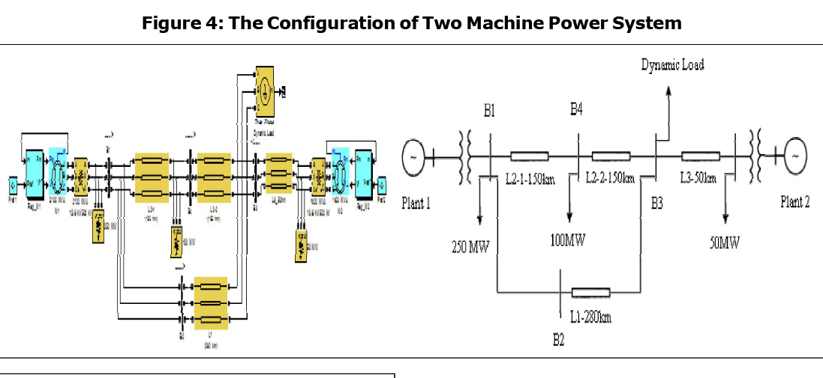

Slide 10
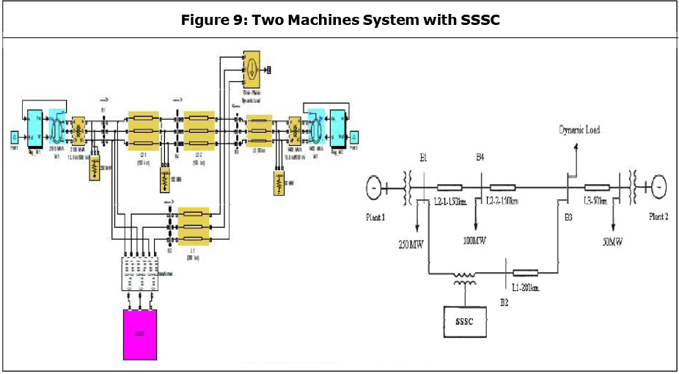

Slide 11
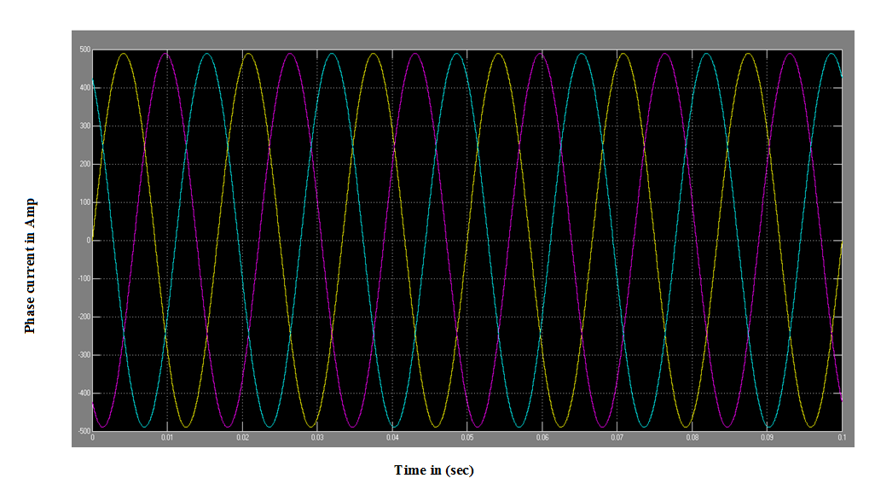
Current of bus-3 without the installation of sssc:

Slide 12
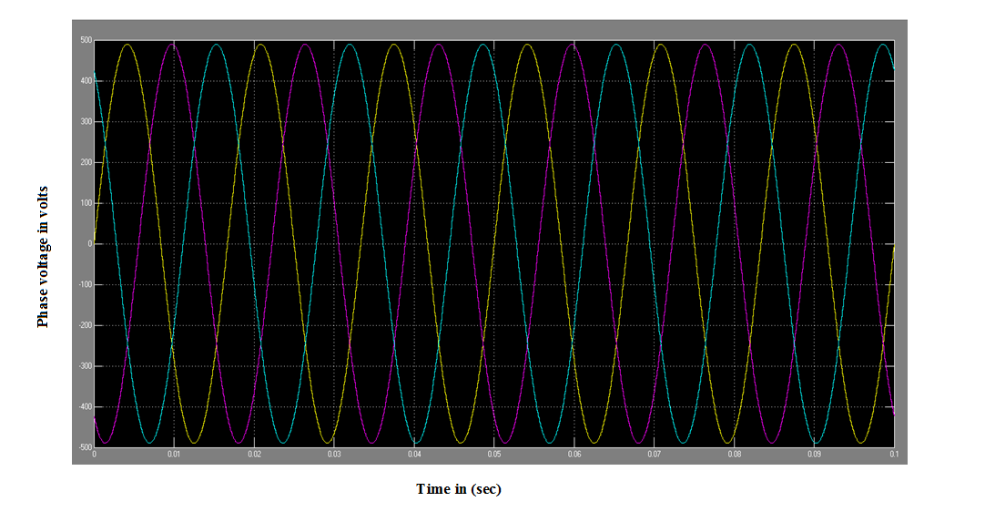
voltage of bus-3 without the installation of sssc:

Slide 13
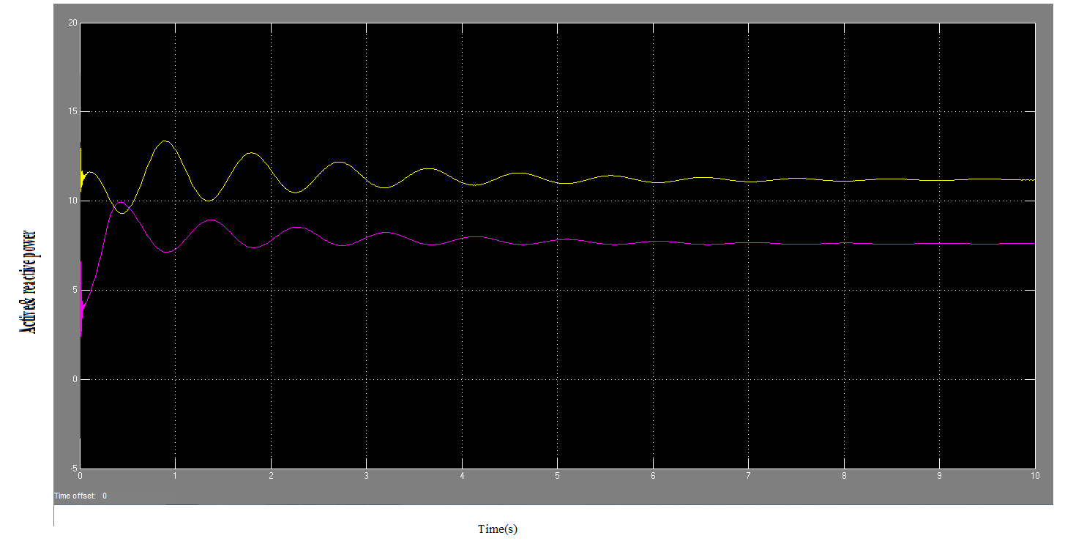
Active and reactive power of bus3 without installation of sssc:

Slide 14
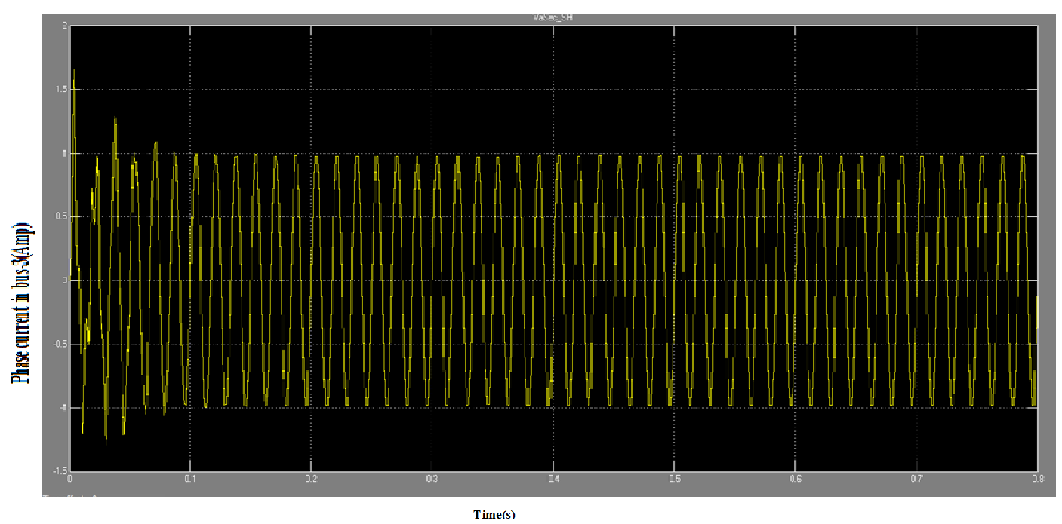
Current of bus-3 in the presence of ssc:
Notes:
Current of bus-3 in the presence of ssc:

Slide 15
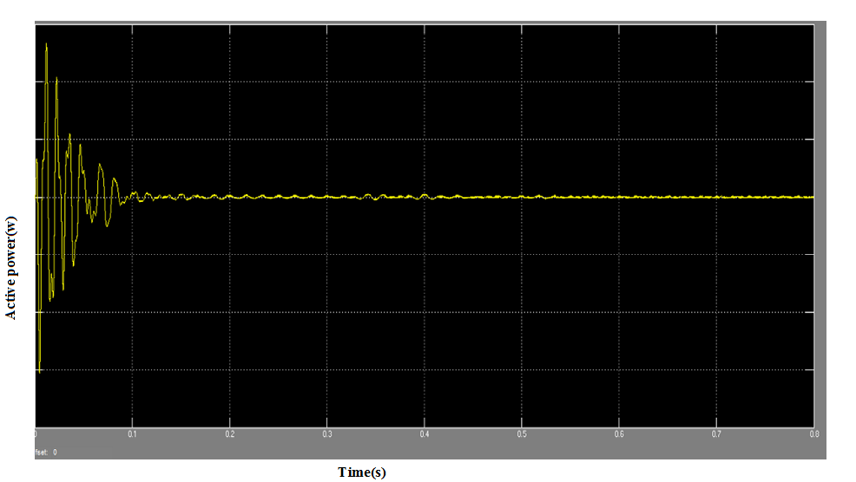
Active power of bus-3 in the presence of sssc:
Notes:
Active power of bus-3 in the presence of sssc:

Slide 16
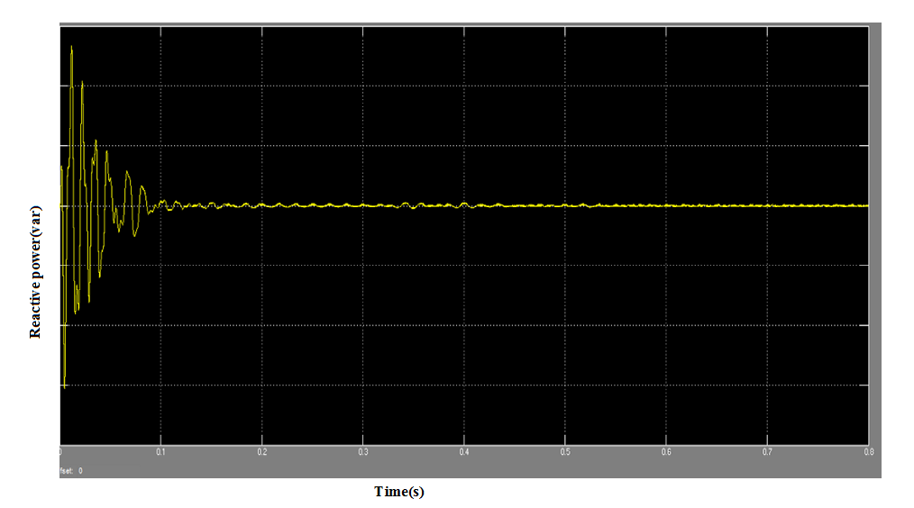
Reactive power of bus-3 in the presence of sssc:

Slide 17
CONCLUSIONS:
It has been found that the SSSC is capable of controlling the flow of power at a desired point on the transmission line. irrespective of the magnitude and phase of the line current. Based on obtained simulation results the performance of the SSSC has been examined in a simple two-machine system simply on the selected bus-3, and applications of the SSSC will be extended in future to a complex and multi-machine system to investigate the problems related to the various modes of power oscillation in the power systems.

Slide 18
THAN'Q'

Slide 19
QUERIES
PLEASE

